Slide 1

UE20CS302 – Machine Intelligence
Mini Project
SPEECH EMOTION RECOGNITION
Team No: 15 Project Team :
Project Guide : Dr. Alpha Vijayan 1. Sehag A PES2UG20CS457
2. Setti Durga Poojitha PES2UG20CS458
3. Shreyas Sai Raman PES2UG20CS461

Slide 2
Problem Statement
Speech emotion recognition is a classification problem where an input sample (audio) is classified into a few predefined emotions such as sadness,happiness,disgust,fear and anger. It does the task of recognizing the emotional aspects of the speech irrespective of the semantic communication.
The model should be able to identify the emotional aspects of the speech or the audio file that has been given as an input to it.The raw audio data would be converted into a numerical values when the feature extraction is done.
The emotions would be predefined as shown before.

Slide 3
Application and Uses
1.Education: A course system of distance education can detect bored users and change the course material.
2. Another upcoming use is to evaluate candidates applying for managerial positions by analyzing their responses during audio or video interviews.
3. On the other hand, SER can help evaluate the performance of existing employees – especially in the call-center industry where an improper conversation with a customer can be disastrous for the company’s image.

Slide 4
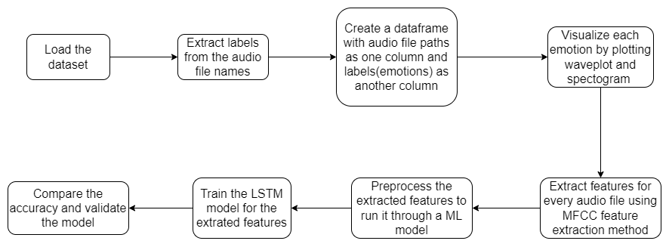
High level Architecture

Slide 5
Literature Survey
Title of the paper | Year of Publication | Journal/Conference Name | Advantages | Limitations
Survey on speech emotion recognition: Features, classification schemes, and databases | 2007 | IEEE International Conference on Acoustics, Speech and Signal Processing - ICASSP ’07, 2007, vol. 4, pp. IV–957–IV–960. | The advantage of this method was better differentiation amongst high and low arousal with neutral emotions compared to HMM. | Other models were not used
Speech Emotion Recognition Using Deep Learning Techniques: A Review | 2019 | IEEE journal article | It was found that CNNs have a time-based distributed network that provides results with greater accuracy | The model was not that efficient..
Emotional speech recognition: Resources, features, and methods | 2006 | Emotional speech recognition: Resources, features, and methods (DimitriosVerveridisConstantineKotropoulos) | Used MfCC for extracting features | One of the major drawbacks of these approaches is the loss of the timing information, because the techniques employ statistics of the prosody features such as the mean, the variance, etc. and neglect the sampling order

Slide 6
Literature Survey
Title of the paper | Year of Publication | Journal/Conference Name | Advantages | Limitations
Speech emotion recognition of decision fusion based on DS evidence theory | 2013 | 2013 IEEE 4th International Conference on Software Engineering and Service Science | HMMIAN hybrid algorithm, THMM and ANN are combined to form an integrated system to classify the speech emotions | However, the experimental results show that correlation of single classifiers will lead to ideal result difficulty.
Speech emotion recognition via ensembling neural networks | 2017 | 2017 Asia-Pacific Signal and Information Processing Association Annual Summit and Conference (APSIPA ASC) | Compared to RNN-based SER method and WRN-based one, the proposed ensemble method shows around 2% and 3% improvement in unweighted accuracy and weighted accuracy | But the improvement from the ensemble learning approach is not significant. It could be due to data imbalance and base classifier design problems.
A survey on Speech emotion recognition | 2019 | 2019 IEEE International Conference on Innovations in Communication, Computing and Instrumentation (ICCI) | Many models were used and comparisons were drawn | If the dimensionality of the issue is too high, then the GMM algorithm can fail to work. This is the main drawback of the GMM algorithm.

Slide 7
Literature Survey
Title of the paper | Year of Publication | Journal/Conference Name | Advantages | Limitations
Speech Emotion Recognition Using Fourier Parameters | 2015 | IEEE Transactions on Affective Computing | a new FP model to extract salient features from emotional speech signals was proposed and validated on three well-known databases including EMODB, CASIA and EESDB. | Good feature extraction techniques were not used
Emotion Recognition Combining Acoustic and Linguistic Features Based on Speech Recognition Results | 2021 | 2021 IEEE 10th Global Conference on Consumer Electronics | emotion-recognition method using linguistic features from speech-recognition results was used | Accuracy of the models used were not upto the mark
Speech emotion recognition based on Gaussian kernel nonlinear proximal support vector machine | 2017 | 2017 Chinese Automation Congress (CAC) | The average recognition correct rate using the SVM method is 80.75% and the average recognition correct rate using PSVM method is 86.75% | The consuming time for SVM method is about two or three times slower than PSVM.

Slide 8
Proposed Approach
We aim to input audio files into our machine learning model and train it accordingly.
After the training phase the model will be able to detect the emotion from the audio files.
We have 8 predefined emotions(anger, fear, disgust, pleasant surprise, surprise, happy, sad).
We used a deep learning technique (LSTM) to train our model.The features were extracted using mfcc technique(mel-frequency cepstrum coefficients).

Slide 9
Results and Discussion
Results:
After using accuracy as a metric,and calculating the validation accuracy,we were able to produce pretty accurate results as our model has given 93.637%.It shows our model was able to predict the data pretty accurately.We also tried checking the accuracy using RNN and compared both the results.

Slide 10
Conclusion
As our model has given pretty good accuracy,LSTM model can be used to implement speech-emotion recognition in the future.
This speech-emotion recognition technique can be used in many areas such as:
Evaluating candidates applying for managerial positions by analyzing their responses during audio or video interviews.
On the other hand, SER can help evaluate the performance of existing employees – especially in the call-center industry where an improper conversation with a customer can be disastrous for the company’s image.
It can be implemented in suicidal helplines

Slide 11
References
1.https://ieeexplore.ieee.org/document/8243198
2.https://ieeexplore.ieee.org/document/7009997
3.https://ieeexplore.ieee.org/author/37089173851
4.https://www.sciencedirect.com/science/article/pii/S0031320310004619?casa_token=PSu-kIQ2pmYAAAAA:1edwwSfGr3RavAvTXzsocY9M8TWf4QgGqnGquTs2qdGTBjPYtBPYzoEPSsn0X-Q50BsRLD_X-oU#!
5.https://www.sciencedirect.com/science/article/pii/S0167639306000422?casa_token=UNibaB01wWIAAAAA:5XYTKUzoRPzAFPOnIjMUoTuDluge93hXYaeijuwzo19Q9G-7-QYkrKfhpMIPIKR2u4j2M1qBiHc#!

Slide 12
Thank You

